Slide 1
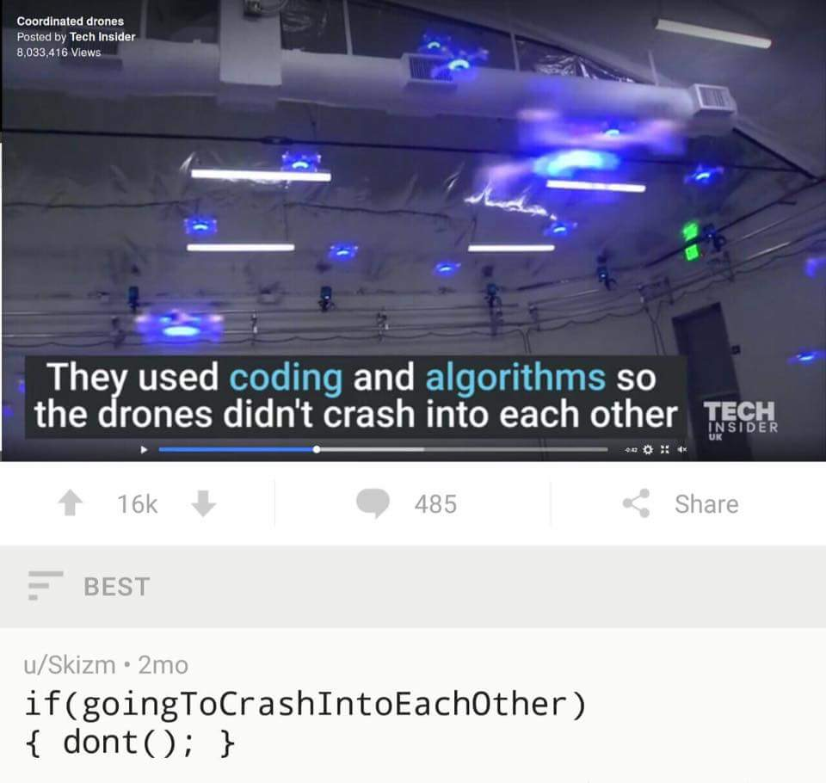
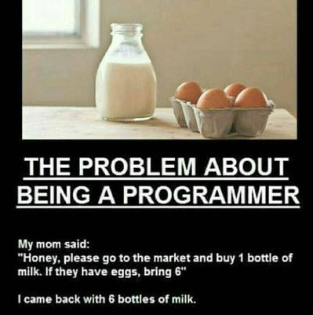
Control statements and loops
The good stuff. Now it starts to be code.

Slide 2
Topics
Introduction: GUI and basic calculations
Coding 1: Scripts, style, and variable classes
Coding 2: Control statements and loops
Visualization 1: Basics, subplots, get and set
Coding 3: Functions
Visualization 2: Descriptive plots
Coding 4: Basic input and output
Visualization 3: Distribution and 3D plots
Coding 5: Input and output specials – last lecture before holidays
Machine Learning 1: Introduction and dimension reduction
Machine Learning 2: Clustering
Machine Learning 3: Classification
Coding 6: Efficiency and debugging basics
Coding 7: Advanced functions and debugging

Slide 3
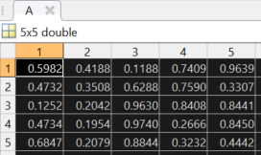
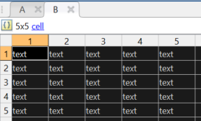
Variable Classes II
Numerics
Scalars, Vectors, Matrices
Indexing with (i), deletion with = []
Integers, doubles, singles
Character arrays
Strings also exist, but char is most frequent
Logicals
True/false, using == ~= < > <= >= or other functions, combined with && and ||
Structs
Flexible and complex, combination of fields and values, indexing by „.“
Cells
Can hold different classes, indexing with {i}
Test with „class()“, is*(), or isa(x,‘<class>‘)

Slide 4
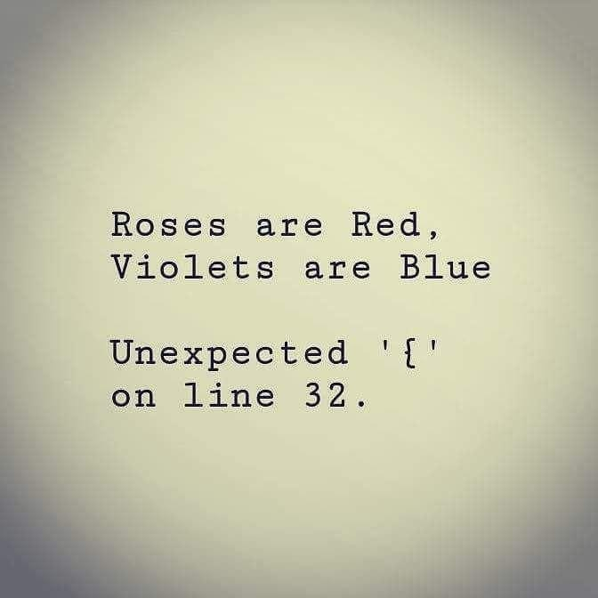
Review: Common Error Messages
Undefined function X for input argument Y
You tried to access something that doesn’t exist, likely a typo in the code
Index exceeds matrix dimensions.
You tried to access a matrix outside its size
Subscripted assignment dimension mismatch.
You tried to stuff something into something else and the dimensions were not the same

Slide 5
Control Statements
Conditional -> Content -> Alternative -> End
If (logical), elseif, else, end
Combine logicals with &&, ||, ~
Switch (variable), case, otherwise, end
For i=x:y, content, end
Repeat code while counting an iterator
i_variable = 1:10, i_variable = [1 3 4 10]
While (toggle_statement), content, end
Repeats code as long as toggle is true
Make sure your code ends!

Slide 6
Notes
For loops for a defined number of iterations
While loops if you don‘t know how often you need to run a code but know when you‘re done
You can use nested control statements (statements inside statements)
Beware, it can get messy fast!
It can help to comment at each end, what exactly ends.

